Slide 1
Special Topic: A Few Tricks of the Trade
Eric Prebys

Slide 2
Linac -> synchrotron injection
Most accelerators start with a linear accelerator, which injects into a synchrotron
In order to maximize the intensity in the synchrotron, we can
Increase the linac current as high as possible and inject over one revolution
There are limits to linac current
Inject over multiple (N) revolutions of the synchrotron
Preferred method
Unfortunately, Liouville’s Theorem says we can’t inject one beam on top of another
Electrons can be injected off orbit and will “cool” down to the equilibrium orbit via synchrotron radiation.
Protons can be injected a small, changing angle to “paint” phase space, resulting in increased emittance
Linac emittance
Synchrotron emittance

Slide 3
Ion (or charge exchange) injection
Magnetic chicane pulsed to move beam out during injection
Circulating Beam
Beam at injection
H⁻ beam from LINAC
Stripping foil
Instead of ionizing Hydrogen, and electron is added to create H⁻, which is accelerated in the linac
A pulsed chicane moves the circulating beam out during injection
An injected H⁻ beam is bent in the opposite direction so it lies on top of the circulating beam
The combined beam passes through a foil, which strips the two electrons, leaving a single, more intense proton beam.
Fermilab was converted from proton to H⁻ during the 70’s
CERN still uses proton injection, but is in the process of upgrading.

Slide 4
Injection and extraction
We typically would like to extract (or inject) beam by switching a magnetic field on between two bunches (order ~10-100 ns)
Unfortunately, getting the required field in such a short time would result in prohibitively high inductive voltages, so we usually do it in two steps:
fast, weak “kicker”
slower (or DC) extraction magnet with zero field on beam path.

Slide 5
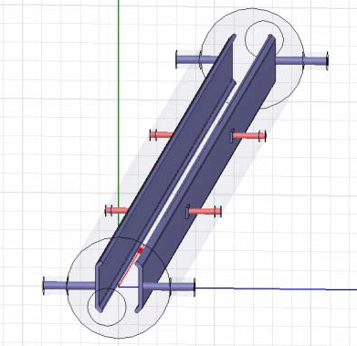
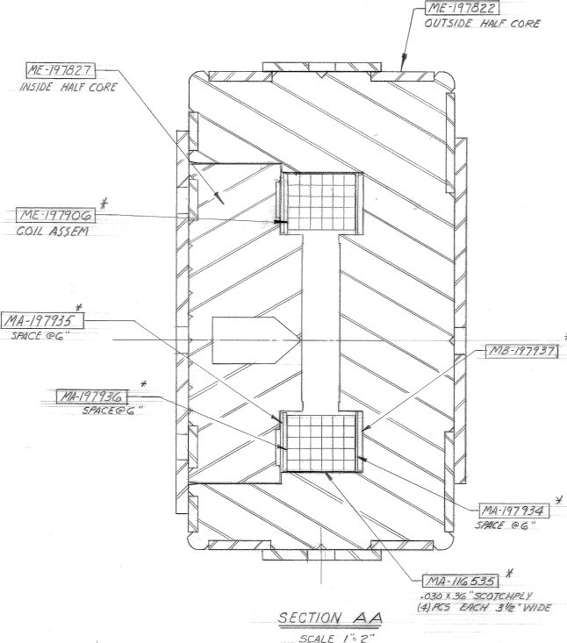
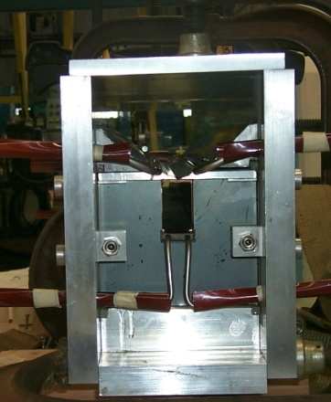
Extraction hardware
“Fast” kicker
usually an impedance matched strip line, with or without ferrites
“Slow” extraction elements
“Lambertson”: usually DC
Septum: pulsed, but slower than the kicker
circulating beam (B=0)
circulating beam (B=0)
B
current “blade”
B
return path

Slide 6
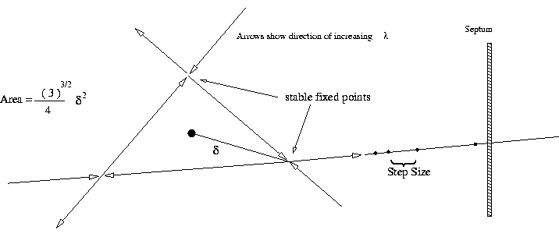
Slow Extraction
A harmonic resonance is generated
Usually sextupoles are used to create a 3rd order resonant instability
Tune the instability so the escaping beam exactly fills the extraction gap between interceptions (3 times around for 3rd order)
Minimum inefficiency ~(septum thickness)/(gap size)
Use electrostatic septum made of a plane of wires. Typical parameters
Septum thickness: .1 mm
Gap: 10 mm
Field: 80 kV
particle flow
E
Particles will flow out of the stable region along lines in phase space into an electrostatic extraction field, which will deflect them into an extraction Lambertson

Slide 7
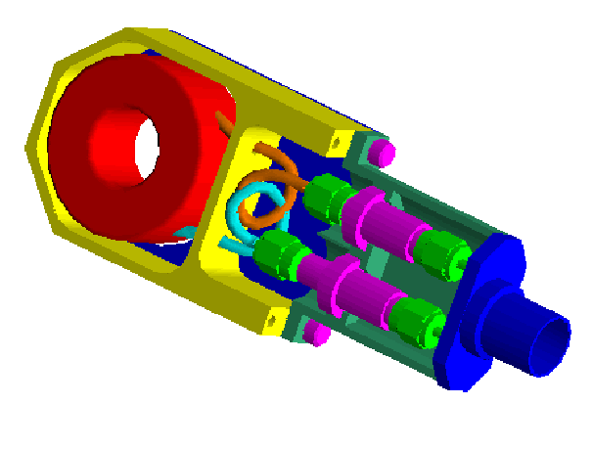
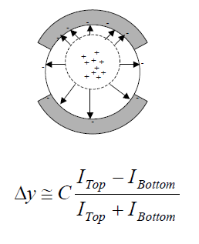
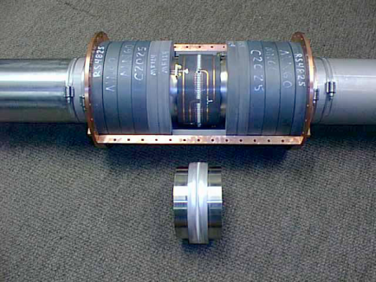
Standard beam instrumentation
Bunch/beam intensity are measured using inductive toriods
Beam position is typically measured with beam position monitors (BPM’s), which measure the induced signal on a opposing pickups
Longitudinal profiles can be measured by introducing a resistor to measure the induced image current on the beam pipe -> Resistive Wall Monitor (RWM)

Slide 8
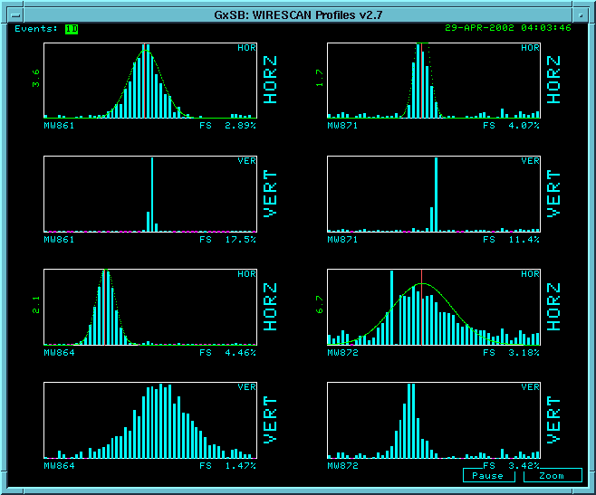
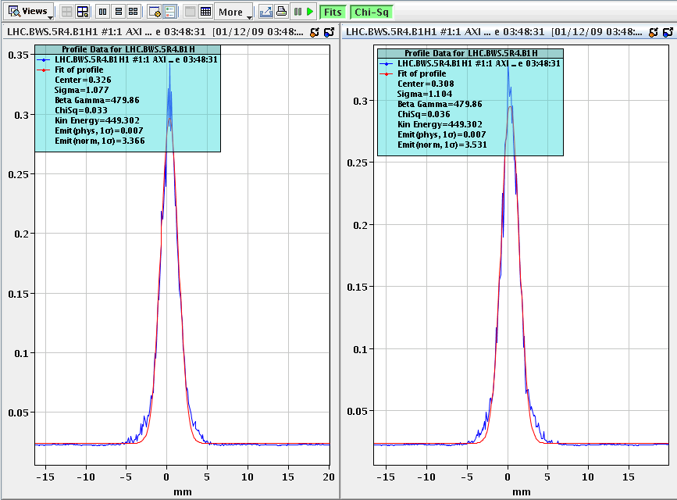
Beam instrumentation (cont’d)
Beam profiles in beam lines can be measured using secondary emission multiwires (MW’s)
Can measure beam profiles in a circulating beam with a “flying wire scanner”, which quickly passes a wire through and measures signal vs time to get profile
Non-desctructive measurements include
Ionization profile monitor (IPM): drift electrons or ions generated by beam passing through residual gas
Synchrotron light
Standard in electron machines
Also works in LHC
Beam profiles in MiniBooNE beam line
Flying wire signal in LHC

Slide 9
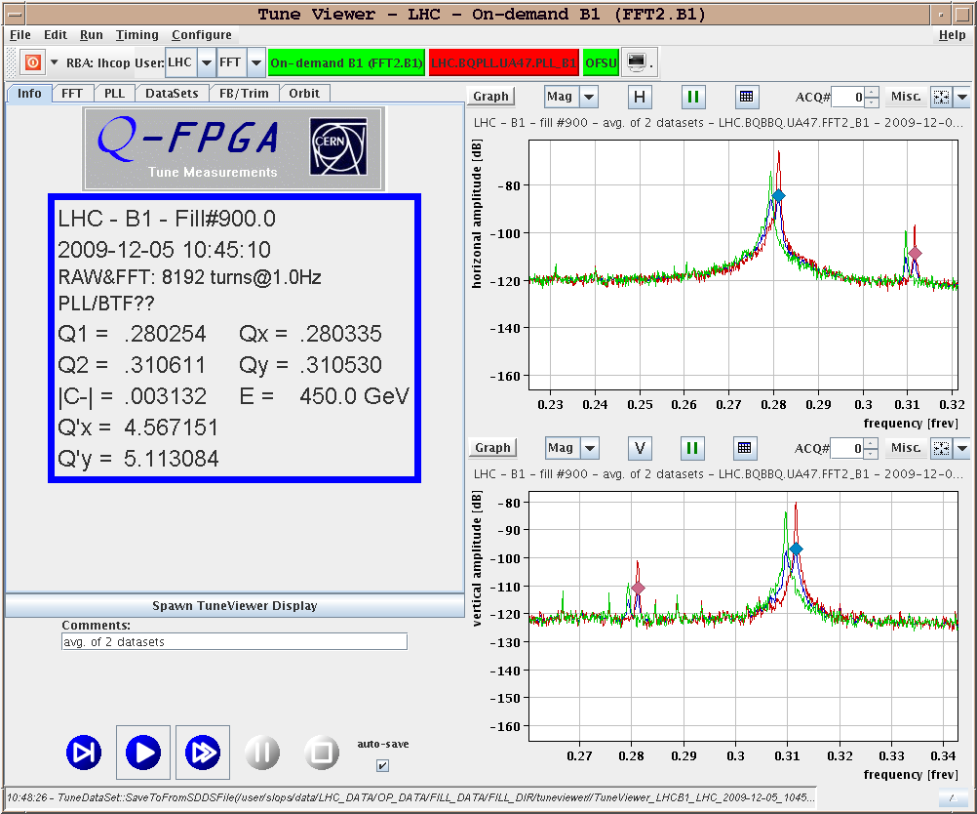
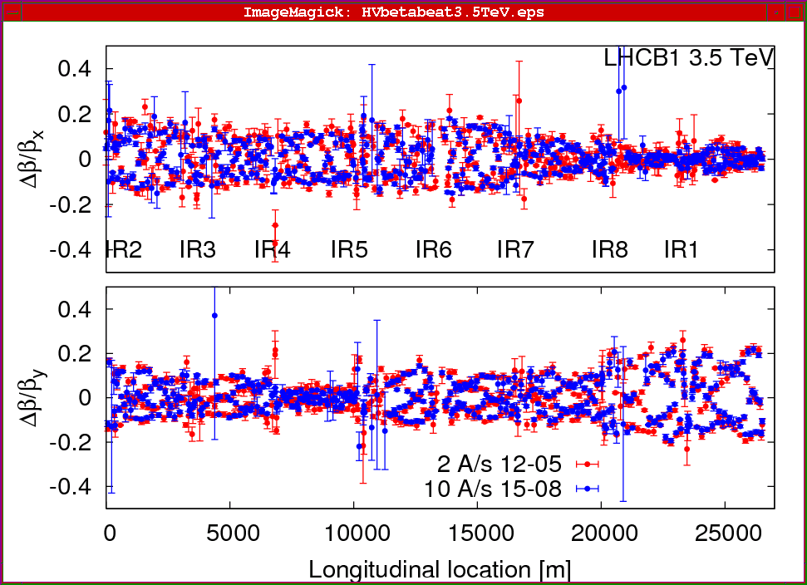
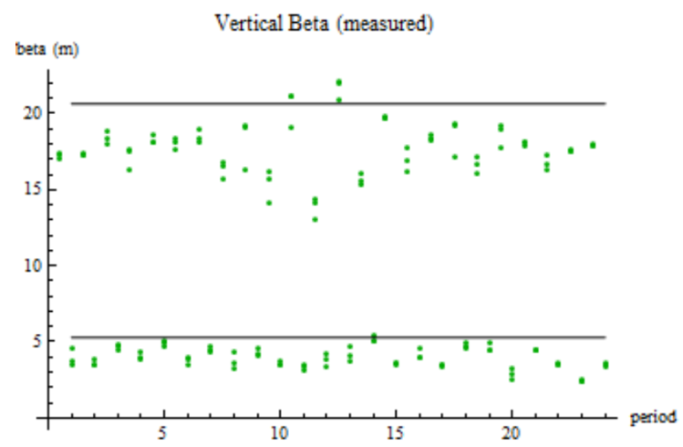
Measuring lattice parameters
The fractional tune is measured by Fourier Transforming signals from the BPM’s
Sometimes need to excite beam with a kicker
Beta functions can be measured by exciting the beam and looking at distortions
Can use kicker or resonant (“AC”) dipole
Can also measure the by functions indirectly by varying a quad and measuring the tune shift

